Slide 1

IST 402 Network Security Password Exchange LM2
Joe Oakes
Penn State Abington

Slide 2

Password Exchange: Message Hiding: Lock-Box
Goal: Need to deliver a secure message between two points
Try to use a lock box
Put the message in a box and lock it
Problem is if someone gets the key from the messenger then they can read the message
Point A
Point B
Key
Message

Slide 3
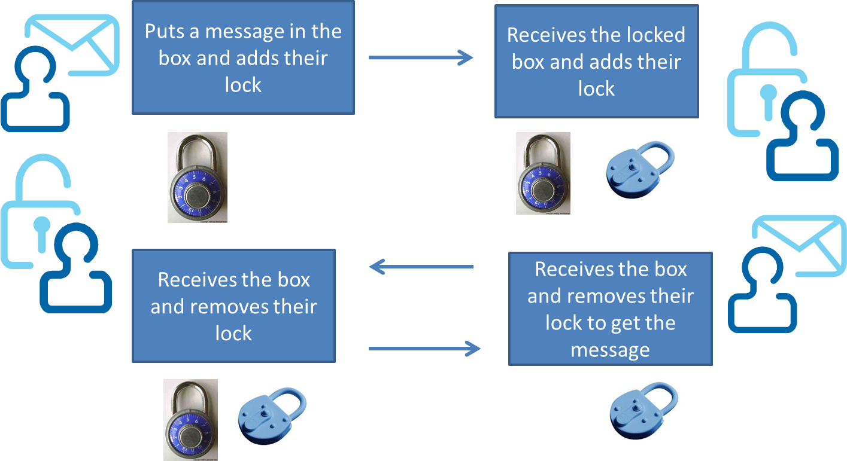
Password Exchange: Message Hiding: Lock-Box
What is message hiding?
How do you get a message from the sender to the receiver without exposing the password or key
Lock-Box Example: the key to the lock is never shared with either party in the exchange

Slide 4
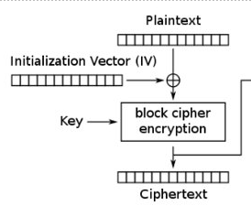
Password Exchange: Cryptography Terms
Plaintext: value to be encrypted that can be read
Ciphertext: Plaintext value that has been encrypted and is unreadable
Base64-encoded: encoding scheme that encodes binary data into numerically and translating it into a base 64 representation
Passphrase: ASCII string password used to generate the encryption Key
Salt: ASCII string used with the passphrase to generate the encryption Key. Simple dictionary attack against the encrypted values becomes impractical

Slide 5
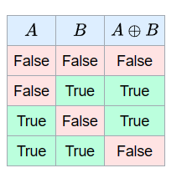
Password Exchange: Cryptography Terms
Initialization Vector: Used to guarantee the use of the same key will result in a different output stream
Key Size: The larger the key size the more overhead it will take to process the encrypting and decrypting of the data. A larger key size will make it more secure.
MAC: Message Authentication Code or HMAC - used to authenticate a message that it came from the sender authenticity (verified by who possess the secret key) and provides message data integrity
Padding is adding data to the message to fill the block
Exclusive or XOR is a logical operation that is true if and only if its arguments differ. Shown as the crosshairs symbol

Slide 6
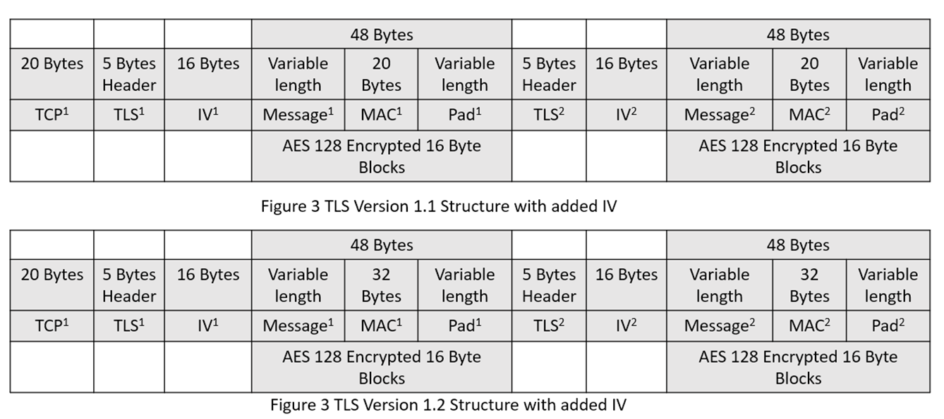
Password Exchange: AES and TLS
AES is a 128-bit (Block size) (16-byte) block cipher - so you need to pad the data to a multiple of 16 bytes
For AES-128, AES-196 and AES-256 - key needs to be either 16, 24 or 32 bytes long

Slide 7
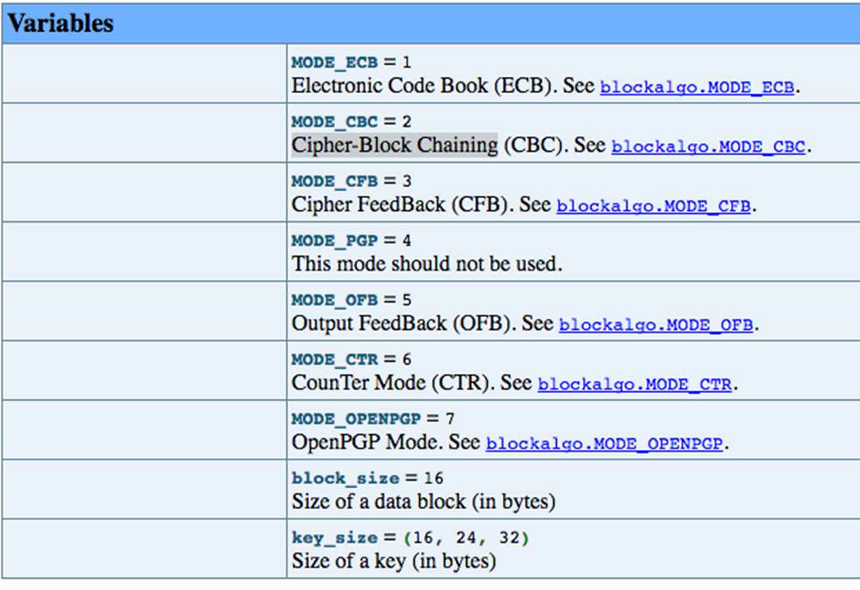
Password Exchange: AES Block Modes of Operation
The following block cipher modes provide confidentiality but do not protect against accidental modification or malicious tampering
ECB and CBC need to be padded before encryption
ECB: Electronic Codebook
CBC: Cipher block chaining
OFB: Output Feedback
CFB: Cipher feedback
CTR Counter

Slide 8
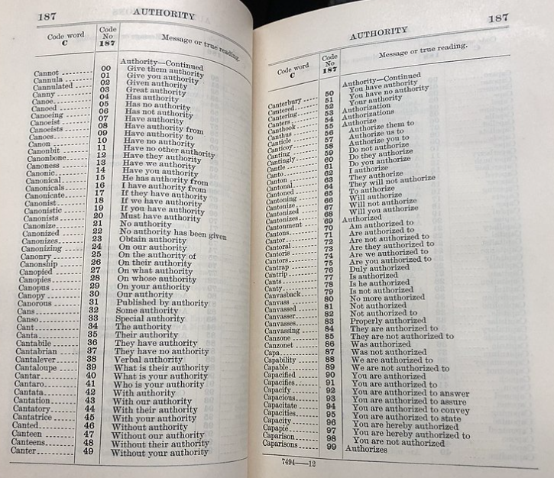
Password Exchange: Electronic Codebook (ECB)
ECB – simplest and not used any more.
A codebook contains a lookup table for coding and decoding; each word or phrase has one or more strings which replace it.
Codebook with superencryption was the most used cryptographic method of World War I
Key - go to page 187
Lookup code # and get the word
No IV no randomness

Slide 9
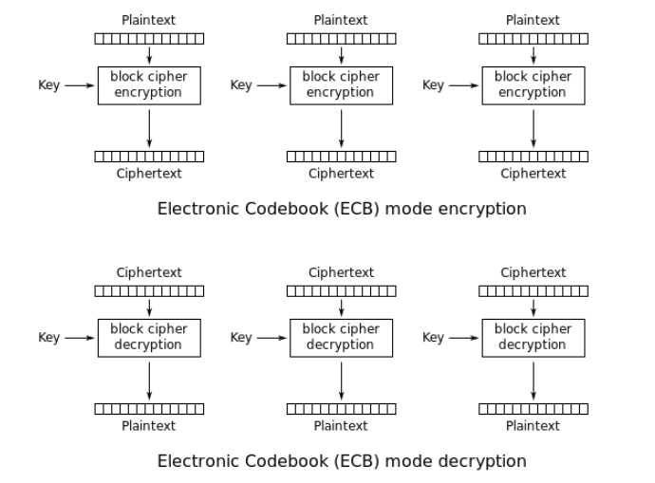
Password Exchange: Electronic Codebook (ECB)
ECB – simplest and not used any more.
64 bit blocks
The message is divided into blocks, and each block is encrypted separately.
ECB uses simple substitution rather than an initialization vector
Because ECB encrypts identical plaintext blocks into identical ciphertext blocks, it does not hide data patterns well.

Slide 10
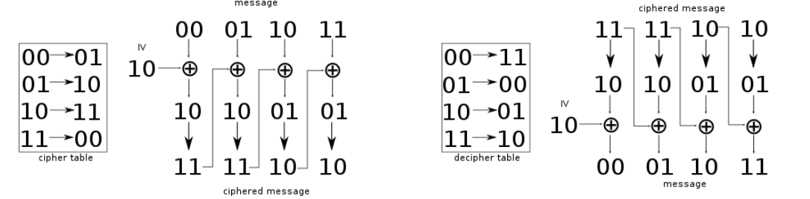
Password Exchange: CBC Block Cipher Mode
CBC Cyber Block Chaining: is a mode of operation where a plaintext block is XORed with the immediately previous ciphertext block, and then encrypted
00 (message) XOR 10 (IV) = 10 cipher table lookup 10 -> 11
01 (message) XOR 11 = 10 cipher table lookup 10 -> 11

Slide 11
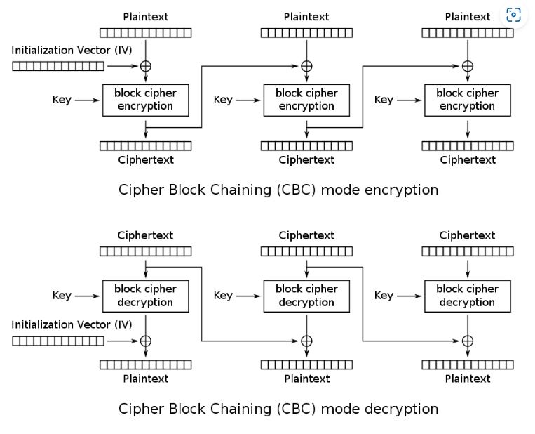
Password Exchange: CBC Block Cipher Mode
CBC Cyber Block Chaining: is a mode of operation where a plaintext block is XORed with the immediately previous ciphertext block, and then encrypted
To make each message unique, an initialization vector must be used in the first block.
This will be used in the python programming example

Slide 12
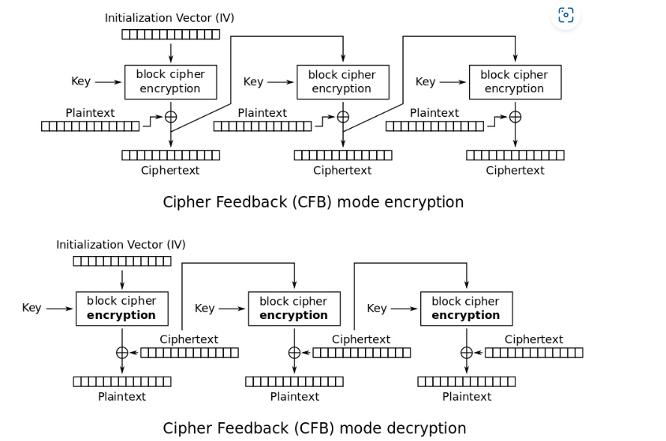
Password Exchange: CBF block cipher mode
CFB Cipher Feedback is a type of block cipher mode
This will be used in the GO programming example

Slide 13
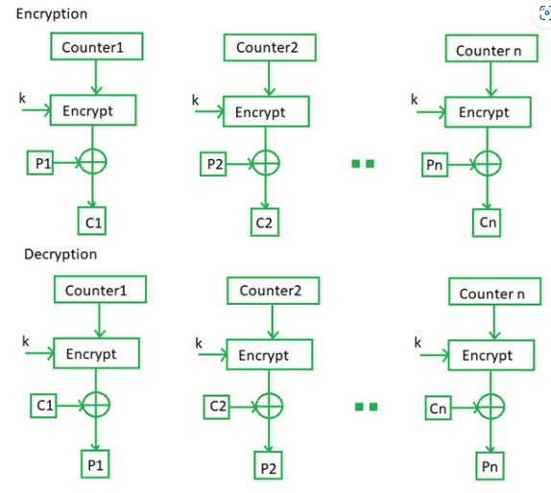
Password Exchange: Counter Mode
Each or every time a counter initiated value is encrypted and given as input to XOR with plaintext or original text which results in ciphertext block
In this mode, both the sender and receiver need to get access to a reliable counter
This shared counter is not necessarily a secret value, but the challenge is that both sides must keep the counter synchronized at a time when both are active

Slide 14
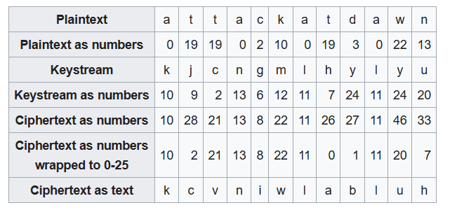
Password Exchange: OFB Output Feedback mode
A stream cipher is a symmetric key cipher where plaintext digits are combined with a pseudorandom cipher digit stream (keystream)
The message attackatdawn becomes kcvniwlabluh
abcd = 0123
It only goes up to 25 so subtract 26 if the value is over 25
19+9 = 28 – 25 = 2 = C

Slide 15
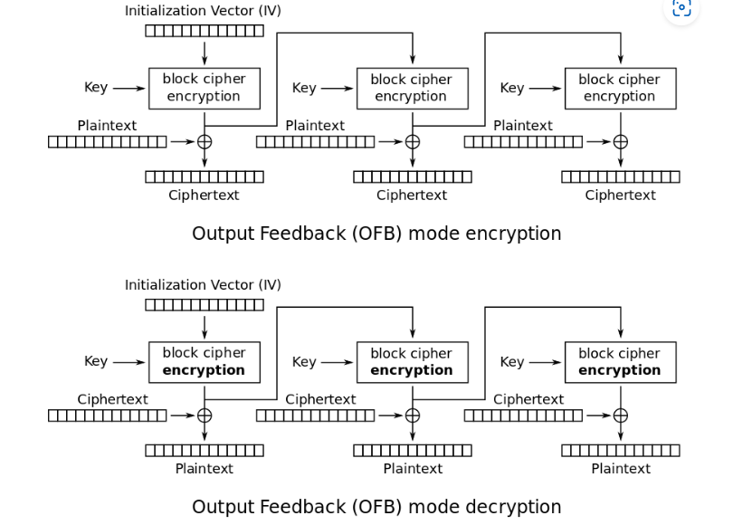
Password Exchange: OFB Output Feedback mode
OFB makes a block cipher into a synchronous stream cipher
Stream ciphers typically execute at a higher speed than block ciphers

Slide 16
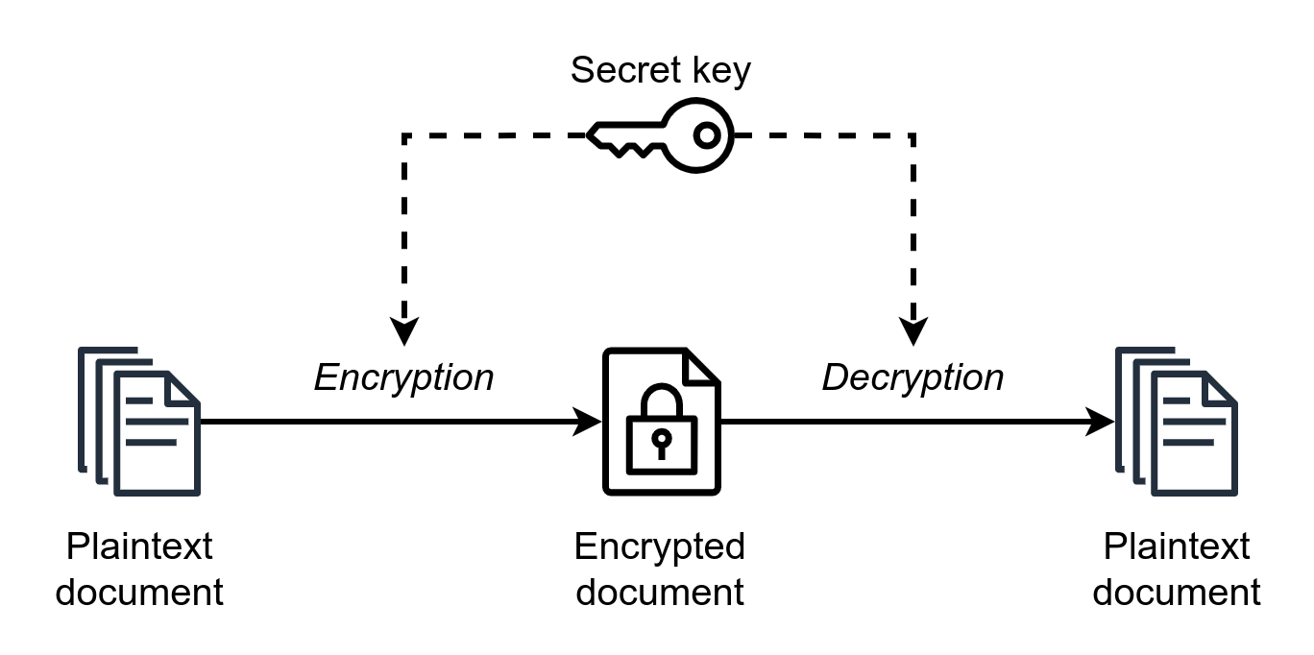
Password Exchange: Symmetric Keys
Symmetric Key/Password Exchange: Uses a shared secret key/password to encrypt and decrypt text known at both end points
Benefits: Fast method of transmission
Cons: how to share the secret password or key with both parties in the exchange without compromising security
Codebook: sharing of keys that each party has

Slide 17
Password Exchange: Key Exhange: asymmetrical cryptography
Before the invention of public-key cryptography we used a single key to encrypt and decrypt messages symmetric-key cryptography
Public-key cryptography uses a two-key system, consisting of the public and the private keys
public/private key pair
RSA (Rivest–Shamir–Adleman) is a public-key cryptosystem
publishes a public key based on two large prime numbers which are kept secret
Messages are encrypted with one key and decrypted with another.
Web Server's Public Key
Client
Uses the Public Key to Encrypt Message
Web Server
Using the Private Key Decrypt the Message
Encrypted Message
Using RSA the Public Key and Private Key are a pair and only the private key can decrypt the message

Slide 18
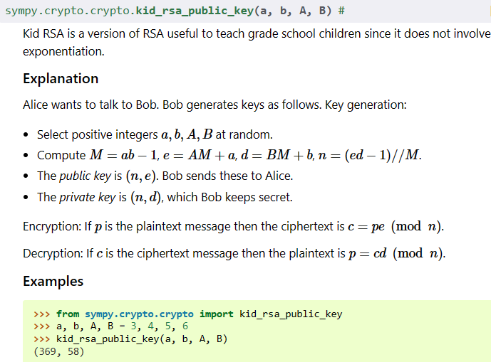
Password Exchange: Kid-RSA
Using SymPy we can use Kid-RSA to generate the keys and encrypt and decrypt

Slide 19
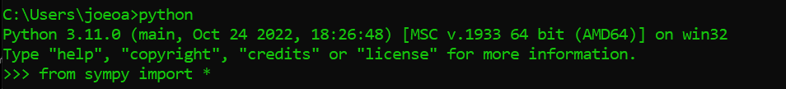
Password Exchange: Kid-RSA
Make sure you have the sympy python library installed and available
Cryptography - SymPy 1.11 documentation

Slide 20
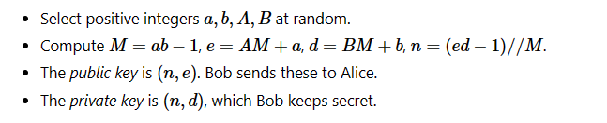
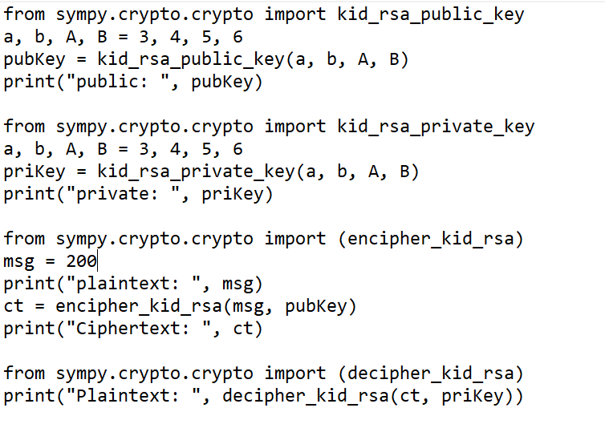
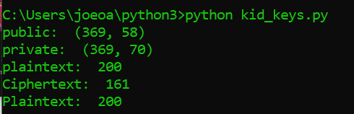
Password Exchange: Kid-RSA
Running

Slide 21
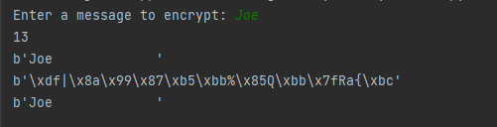
Password Exchange: AES Python Code
from Crypto.Cipher import AES
pad = b' '
obj = AES.new(bytes('This is a key123',encoding ='utf-8'), AES.MODE_CBC, bytes('This is an IV456',encoding ='utf8'))
message = input("Enter a message to encrypt: ")
plaintext = message.encode('utf-8')
length = 16 - (len(plaintext)%16)
print(length)
plaintext += length*pad
print(plaintext)
ciphertext = obj.encrypt(plaintext)
print(ciphertext)
#Perform the decryption on the message
obj2 = AES.new(bytes('This is a key123',encoding ='utf-8'), AES.MODE_CBC, bytes('This is an IV456',encoding ='utf8'))
print(obj2.decrypt(ciphertext))
library
Make sure to perform a pip install
pip install pycryptodome
Notice the key is known for both the encryption and decryption areas
AES is a block Cipher so it must be padded to a full block
encode
encrypt
decrypt

Slide 22
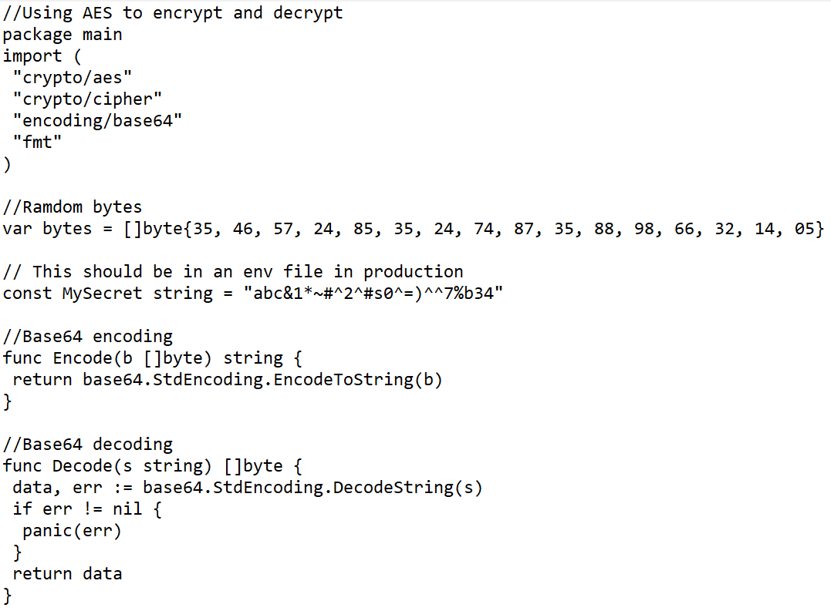
Password Exchange: AES GoLang Code: Setup and Support
go packages needed
Initialization Vector
Password/Secret
Encoding function
Decoding function

Slide 23
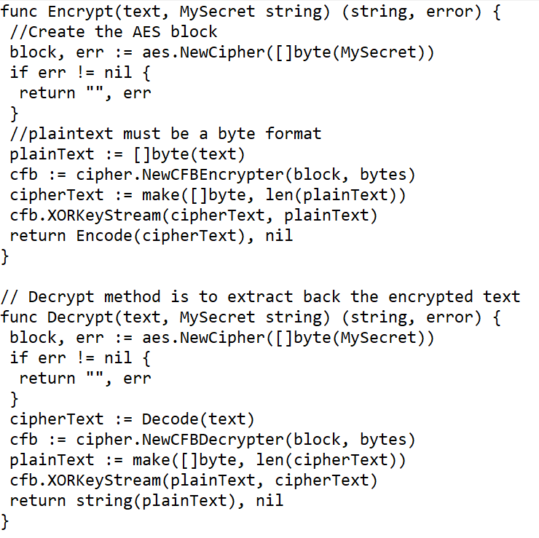
Password Exchange: AES GoLang Code: encrypt and decrypt
AES Block
Handle Errors
encrypt
encode
AES Block
Handle Errors
decode
decrypt

Slide 24
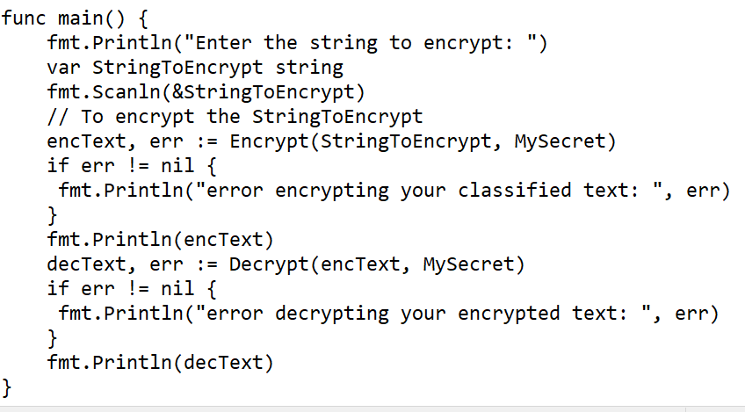
Password Exchange: AES GoLang Code: main function
User input plaintext
Encrypt function
Handle Errors
Decrypt function
Handle Errors
Decrypted Text

Slide 25
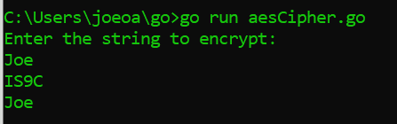
Password Exchange: AES GoLang Code: Running Program

Slide 26
Password Exchange: Works Cited
https://www.geeksforgeeks.org/block-cipher-modes-of-operation/
Cryptography - SymPy 1.11 documentation

